Slide 1


Lesson 3
User Input & Data Types

Slide 2
Learning Objectives
By the end of this lesson, you will…
Understand how to use EduBlocks
Understand how to capture user input
Understand how to identify different data types

Slide 3
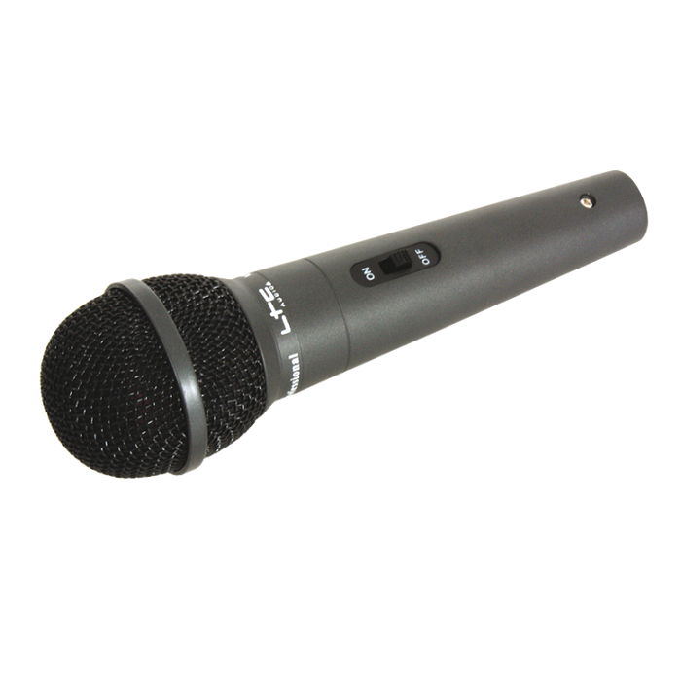
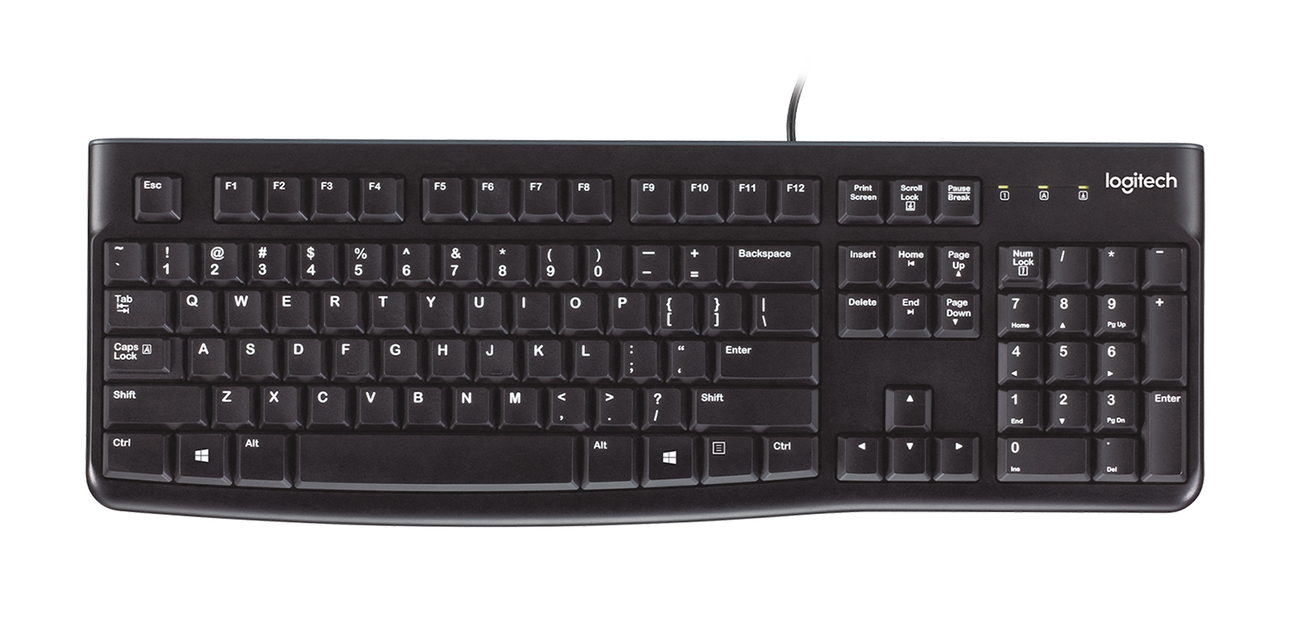
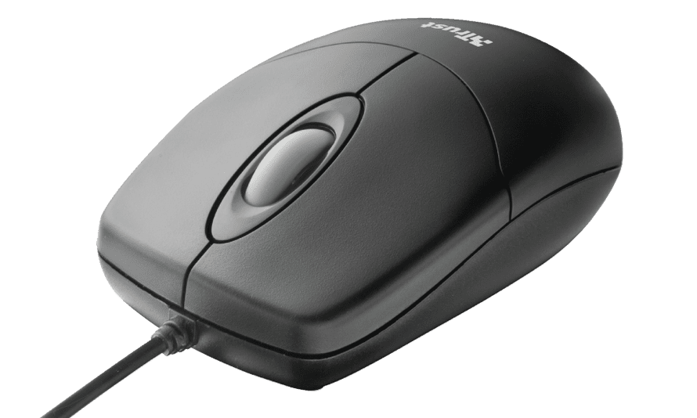
Lesson 3
What is Input?
How many forms of input can you name?
Traditionally user input refers to keyboard input

Slide 4
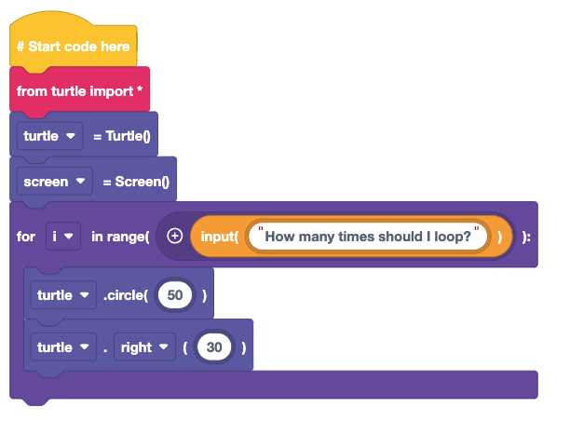
Lesson 3
How can we use the input?
User input is a way that the computer can ask a question
The input block is found in the statements section
What will this code do?
What happens when you run it?
Why does it do that?

Slide 5
Lesson 3
What happened?
There was an error!
But what does this mean?
Data types tell a computer how we want to use the data
For a loop, we need to use an integer, a number with no decimal place
But a use input captures the number as a string, a sequence of characters

Slide 6
Lesson 3
Basic data types
At the basic level there are three data types
String
A sequence of characters, including punctuation, numbers and letters.
Integer
A number with no decimal place
Float
A number with a decimal place
Give examples of where each of these data types can be used

Slide 7
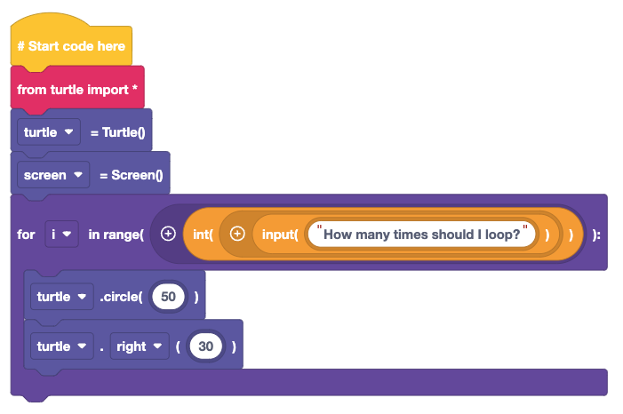
Lesson 3
How can we fix the error?
We need to convert the string to an integer
Use the int(1) block from statements
Wrap it around the input() block
What happens?
How can we improve the code?

Slide 8
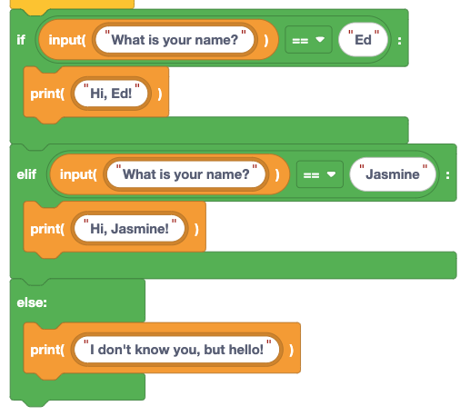
Lesson 3
If, else if and else
How do we make a decision?
How does a computer?
Here if we answer with either “Ed” or “Jasmine” then the computer will say hello.
But if it does not know our name, it will just say hello.

Slide 9
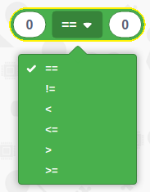
Lesson 3
Logical Thinking
Our conditional test uses logic to check the user input against a value
==
Values must be equal
!=
Values must NOT be equal
<
Left value is less than right value
<=
Left value is less than or equal to right value
>
Left value is greater than right value
>=
Left value is greater than or equal to right value

Slide 10

Lesson 3
Drawing shapes, logically
In this sequence of code, we use logic to draw one of two shapes
If the user input is square, then a for loop is used to draw a square
Else if the user input is a circle, a circle is drawn
If we type in something else, the else condition will activate to apologise to the user.

Slide 11
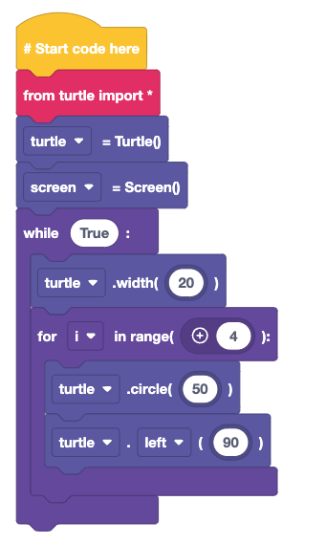
Lesson 3
Challenge!
Can you write some code to ask…
What width should the pen be?
How many times should the code loop?
What angle should the turn be?
Where do we add/make changes to the code. Change one section at a time, run the code and see what happens!

Slide 12
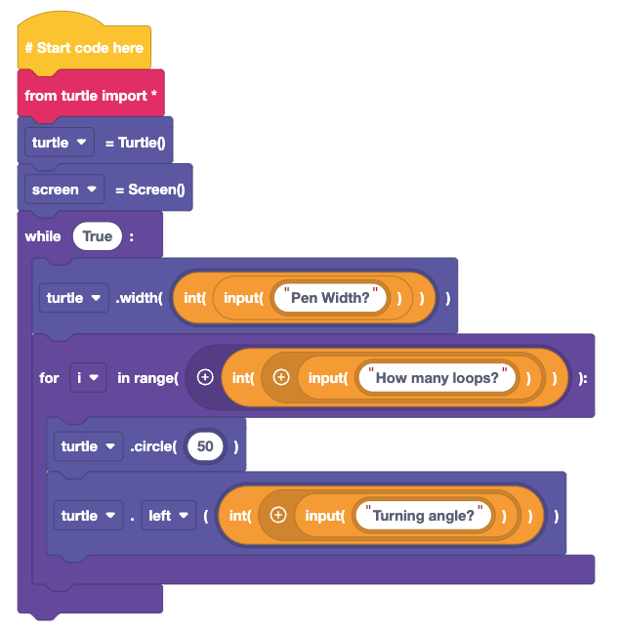
Lesson 3
Challenge Solution
Does this code look like yours?
The pen width user input was a string, as the turtle.width() command does not rely on a set data type
But our loop and turning angle answers require an integer to work

Slide 13
Plenary
What have we learnt?
How to capture user input
How to use specific data types for tasks
How to use conditional logic in our code

Slide 14
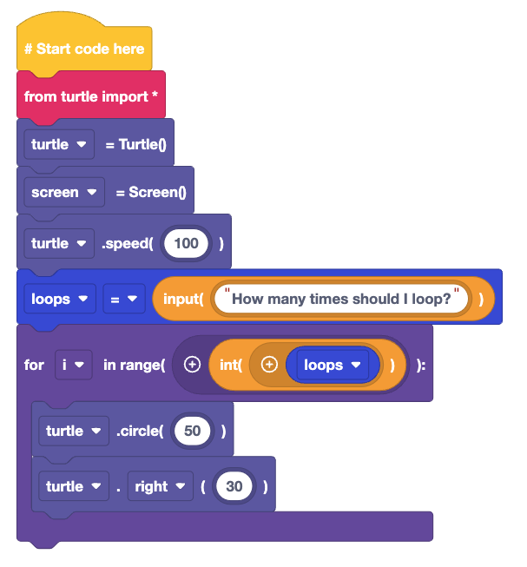
Plenary
Next Lesson
Next Lesson we will use EduBlocks to capture user input into a variable and use that with conditional logic

